Slide 1
Lab 8 – NA
NC – Saad Masood

Slide 2
Exercise 1 (f1)
Define a function in f1.m file
function y=f1(x)
y= x^2-9;
Draw the graph of f(x)= x^2-9 in command window.
>> fplot(‘f1', [0 5])
>>grid on
The root is lying in the interval [2.5 3.5]

Slide 3
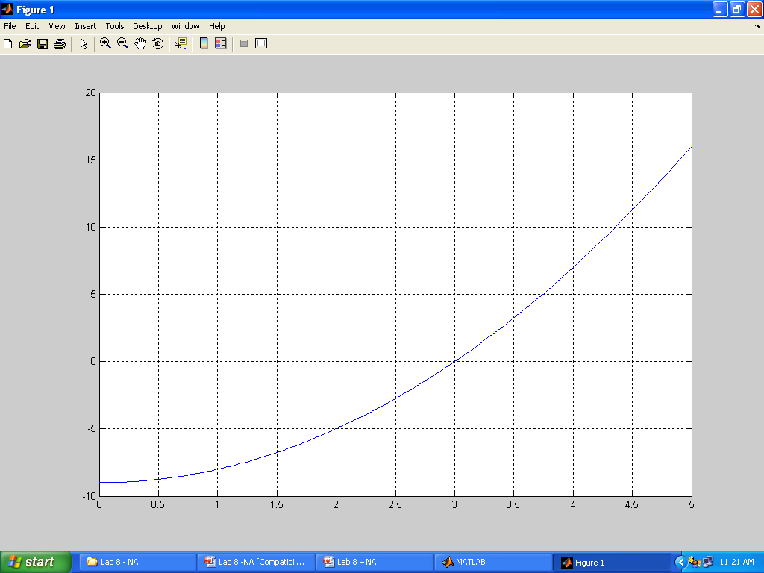

Slide 4

Exercise 1 (f1)
[k,c,err,yc]=Bisection('f1',2.5,3.5,1e-5)
k =1
c =3
err =0
yc =0

Slide 5
Exercise 1 (f2)
Define a function in f2.m file
function y=f2(x)
y= x^6-x-1;
Draw the graph of f(x)= x^6-x-1 in command window.
>> fplot(‘f2', [1 2])
>>grid on
The root is lying in the interval [1.1 1.2]

Slide 6
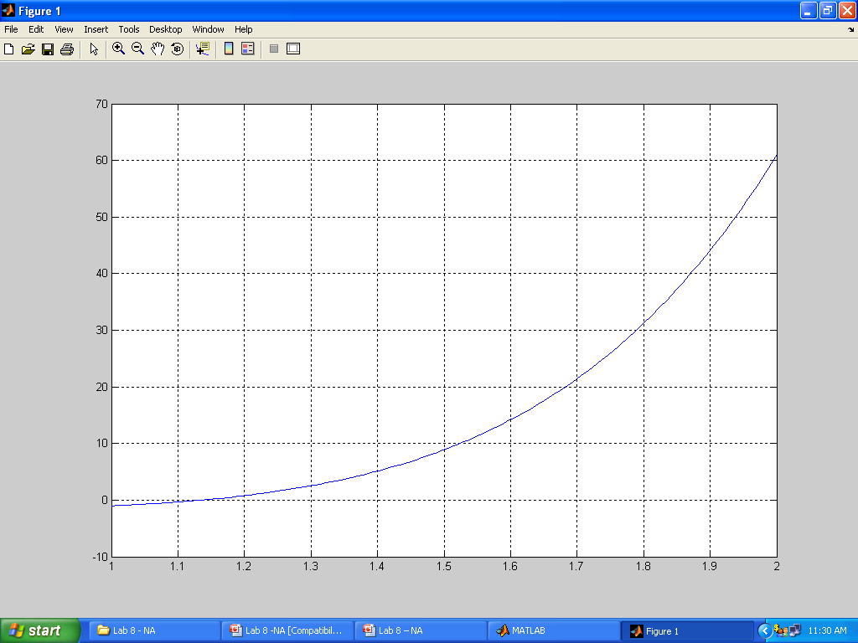

Slide 7
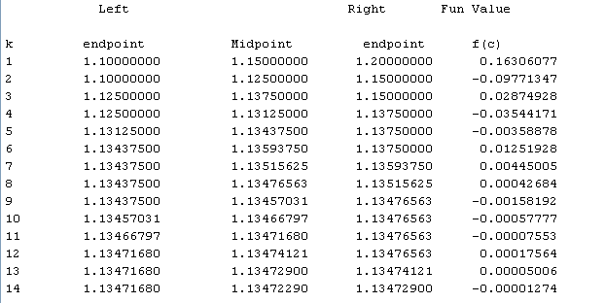
Exercise 1 (f2)
[k c err yc]=Bisection('f2',1.1,1.2,1e-5)
k =14
c =1.1347
err = 6.1035e-006
yc =1.8659e-005

Slide 8
Exercise 1 (f3)
Define a function in f3.m file
function y=f3(x)
y= 2*x-exp(-x);
Draw the graph of f(x)= 2*x-exp(-x) in command window.
>> fplot(‘f3', [-10 10])
>>grid on
The root is lying in the interval [-6 4]

Slide 9
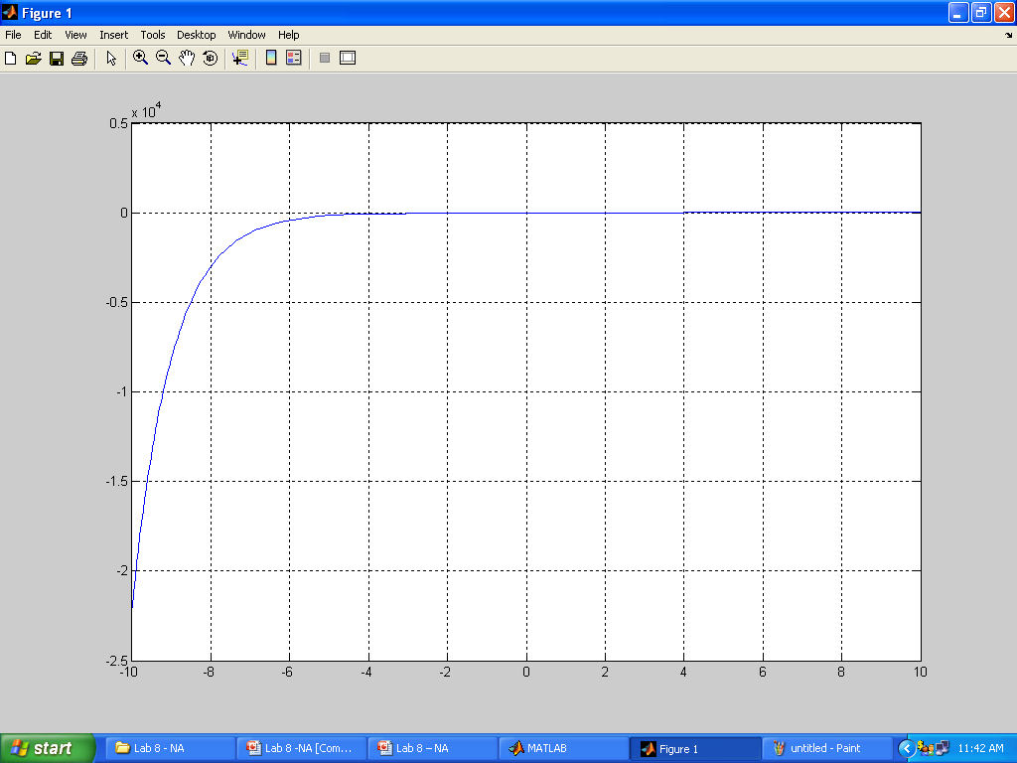

Slide 10
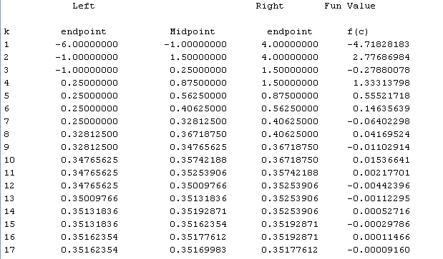
Exercise 1 (f3)
[k c err yc]=Bisection('f3',-6,4,1e-4)
k = 17
c = 0.3517
err = 7.6294e-005
yc = 1.1530e-005

Slide 11
Exercise 2 (Q1)
Define a function in Q1.m file
function y=Q1(x)
y= x^2 - 3;
Draw the graph of f(x)= x^2 - 3 in command window.
>> fplot(‘Q1', [1, 2])
>>grid on
The root is lying in the interval [1.7 1.8]

Slide 12
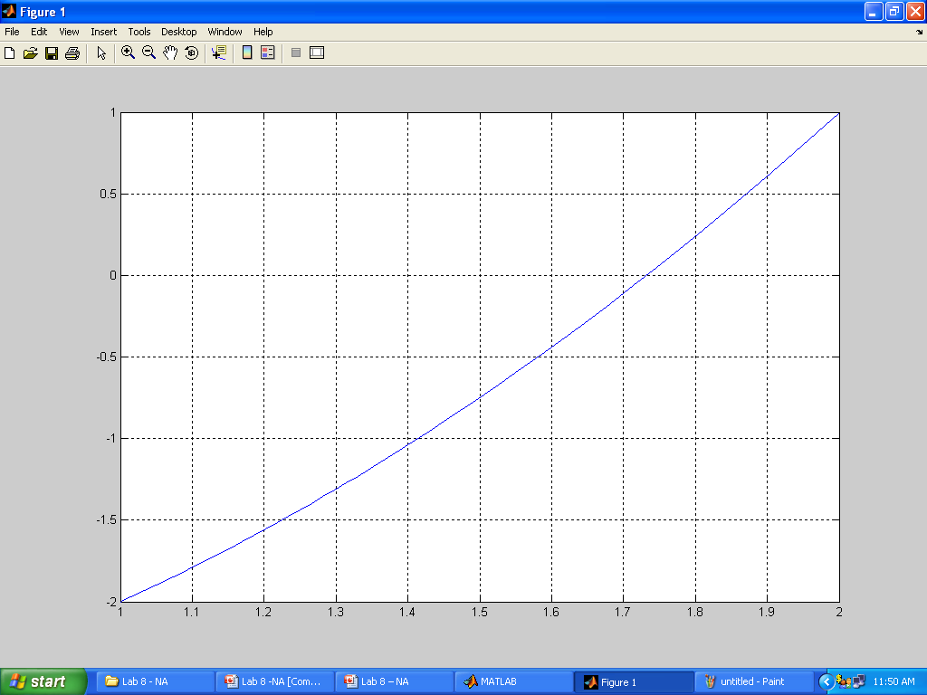

Slide 13
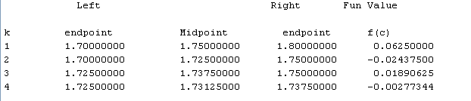
Exercise 2 (Q1)
[k c err yc]=Bisection('Q1',1.7,1.8,0.01)
k = 4
c = 1.7344
err = 0.0062
yc = 0.0081

Slide 14
Exercise 2 (Q2)
Define a function in Q2.m file
function y=Q2(x)
y= exp(-x)*(3.2*sin(x) - 0.5*cos(x));
Draw the graph of f(x)= exp(-x)*(3.2*sin(x) - 0.5*cos(x)) in command window.
>> fplot(‘Q2', [3, 4])
>>grid on
The root is lying in the interval [3.2 3.4]

Slide 15
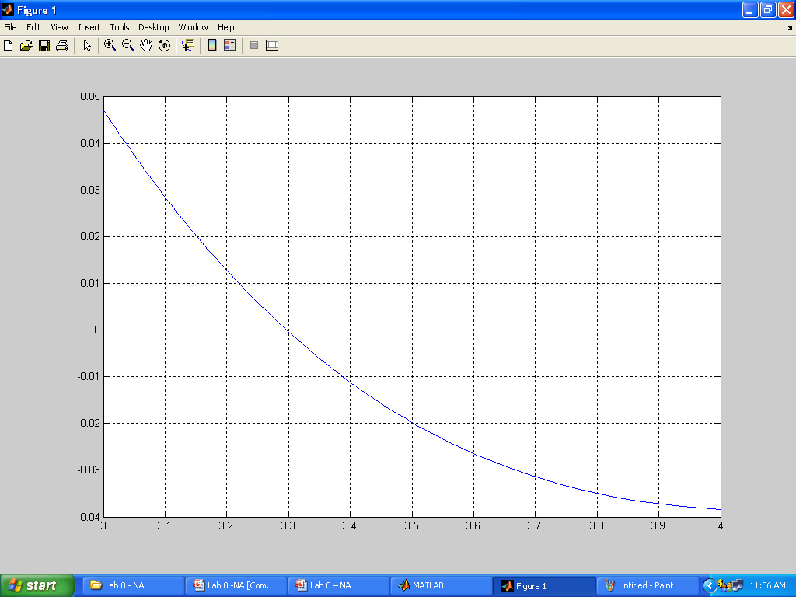

Slide 16
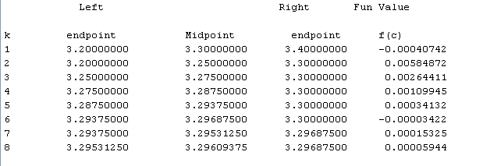
Exercise 2 (Q2)
[k c err yc]=Bisection('Q1',1.7,1.8,0.01)
k = 8
c = 3.2965
err = 7.8125e-004
yc = 1.2590e-005

